Slide 1
Unsupervised Learning: Linear Dimension Reduction

Slide 2

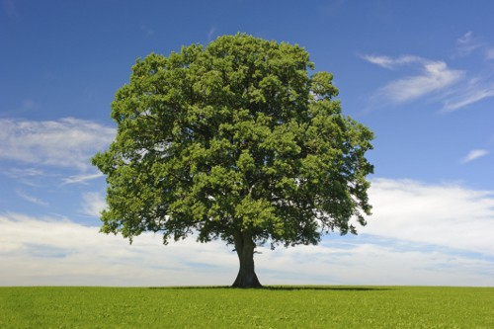
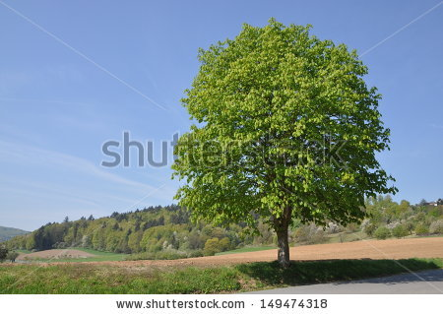
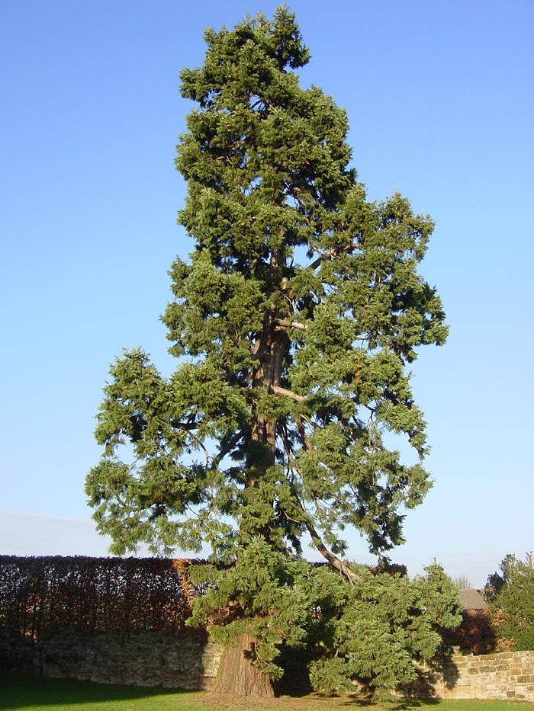
Unsupervised Learning
Clustering & Dimension Reduction (化繁為簡)
Generation (無中生有)
only having function input
only having function output
function
function
code
Clustering & Dimension Reduction in these slides

Slide 3



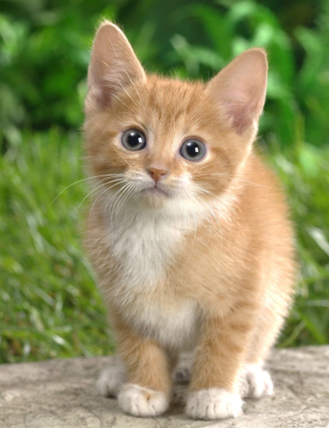
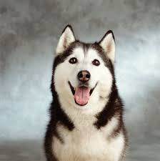
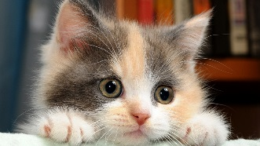

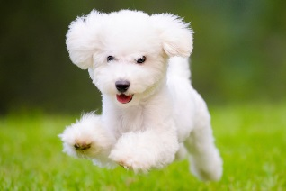
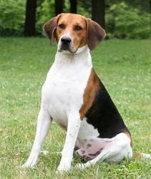
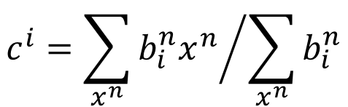
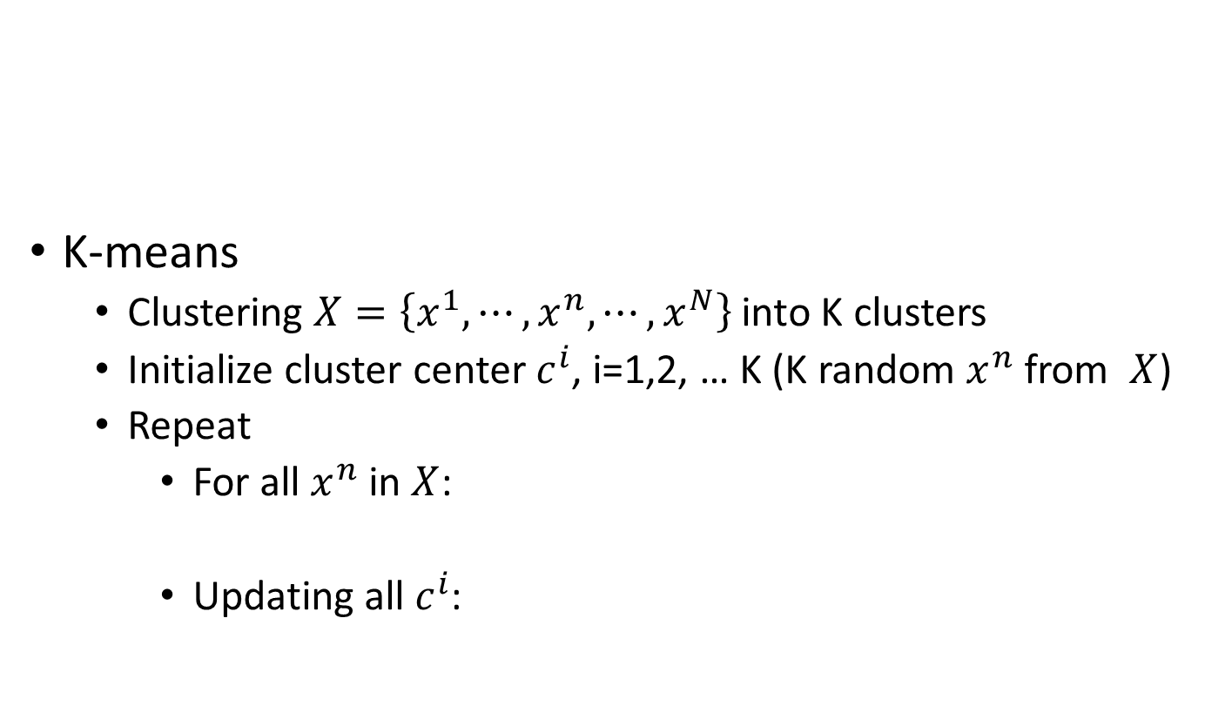
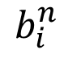
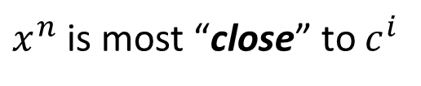
Clustering
Cluster 3
Open question: how many clusters do we need?
K-means
Clustering $X=\left\{x^{1},⋯,x^{n},⋯,x^{N}\right\}$ into K clusters
Initialize cluster center $c^{i}$, i=1,2, … K (K random $x^{n}$ from $X$)
Repeat
For all $x^{n}$ in $X$:
Updating all $c^{i}$:
Cluster 1
Cluster 2
1
$x^{n}$ is most “close” to $c^{i}$
$$b_{i}^{n}$$
0
Otherwise
$$c^{i}={\sum_{x^{n}}{b_{i}^{n}x^{n}}}/{\sum_{x^{n}}{b_{i}^{n}}}$$

Slide 4
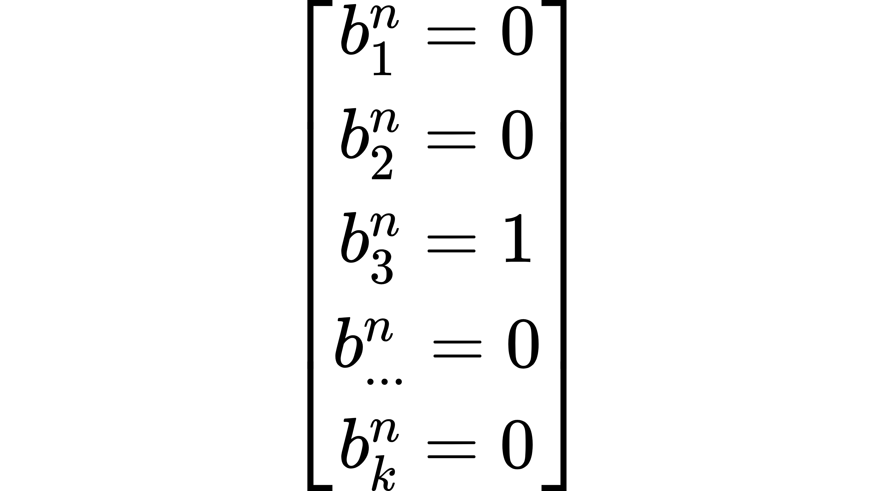
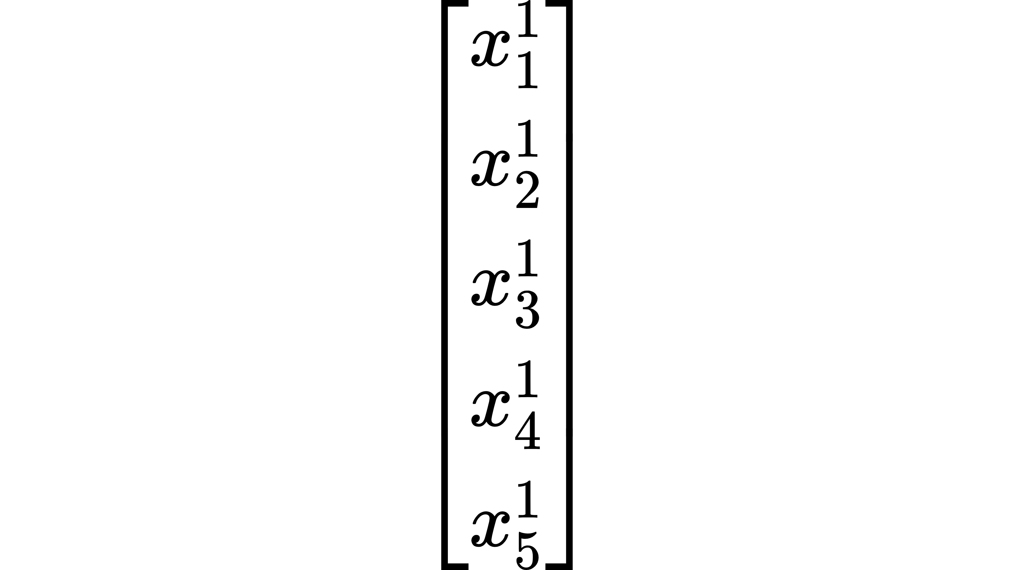
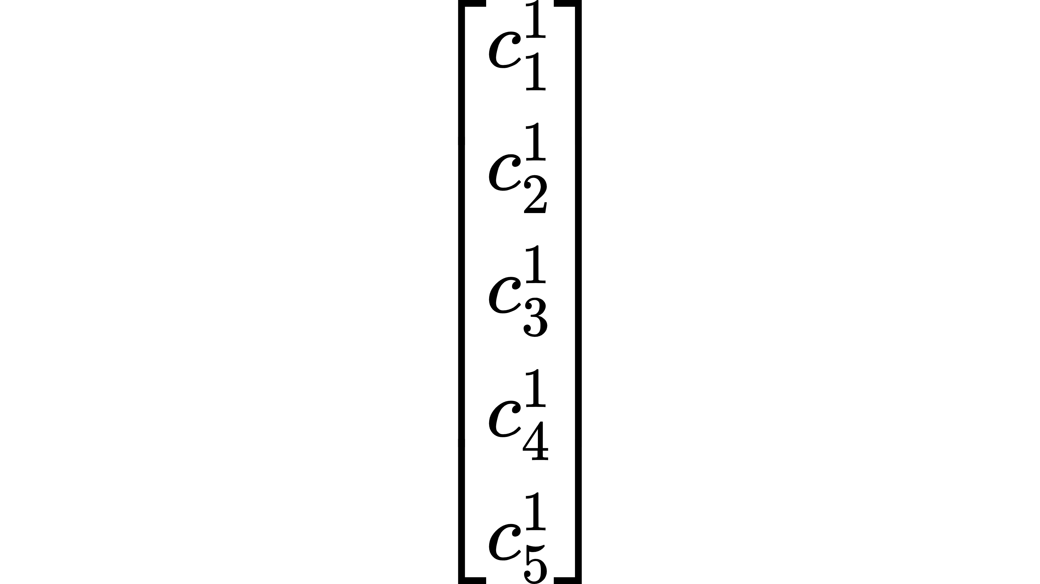
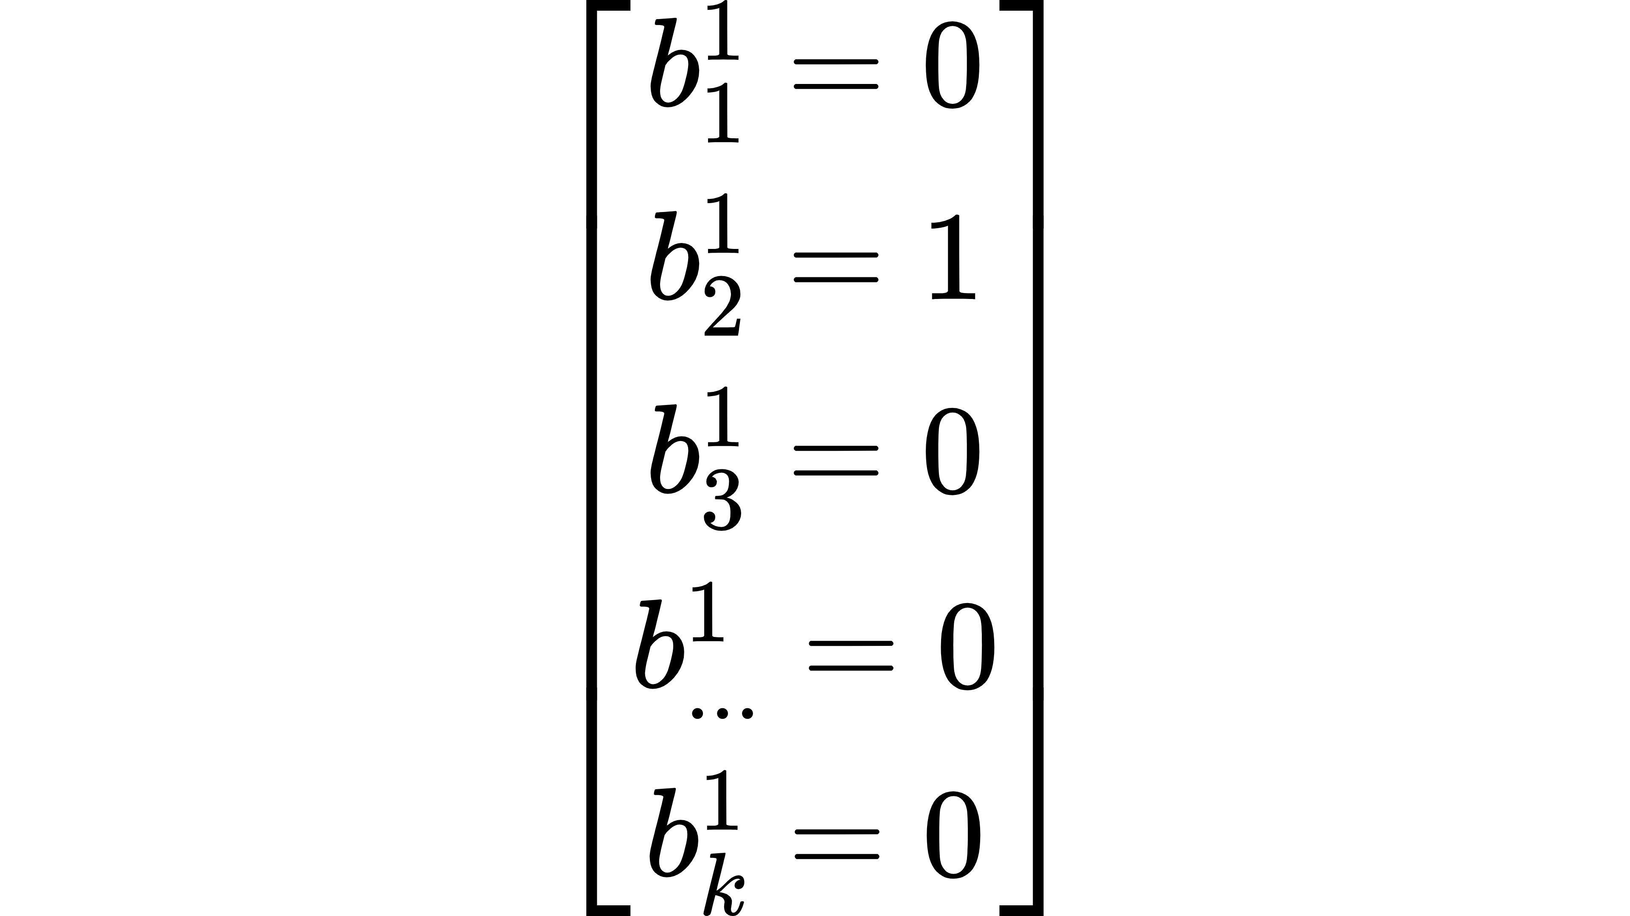
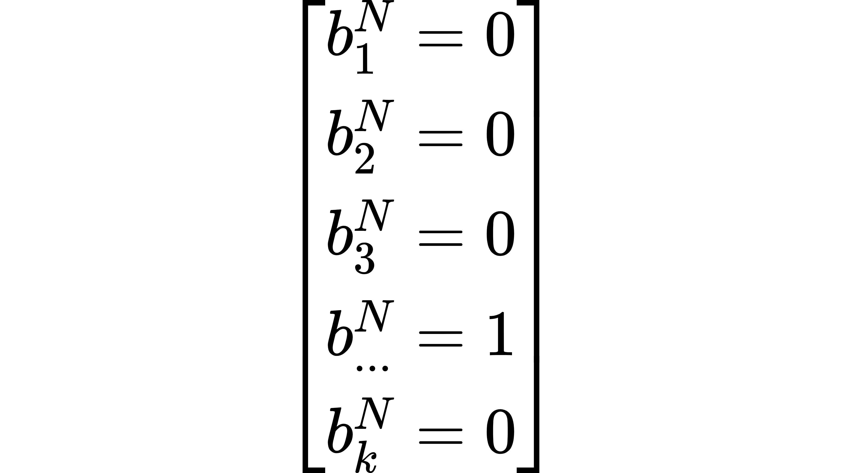
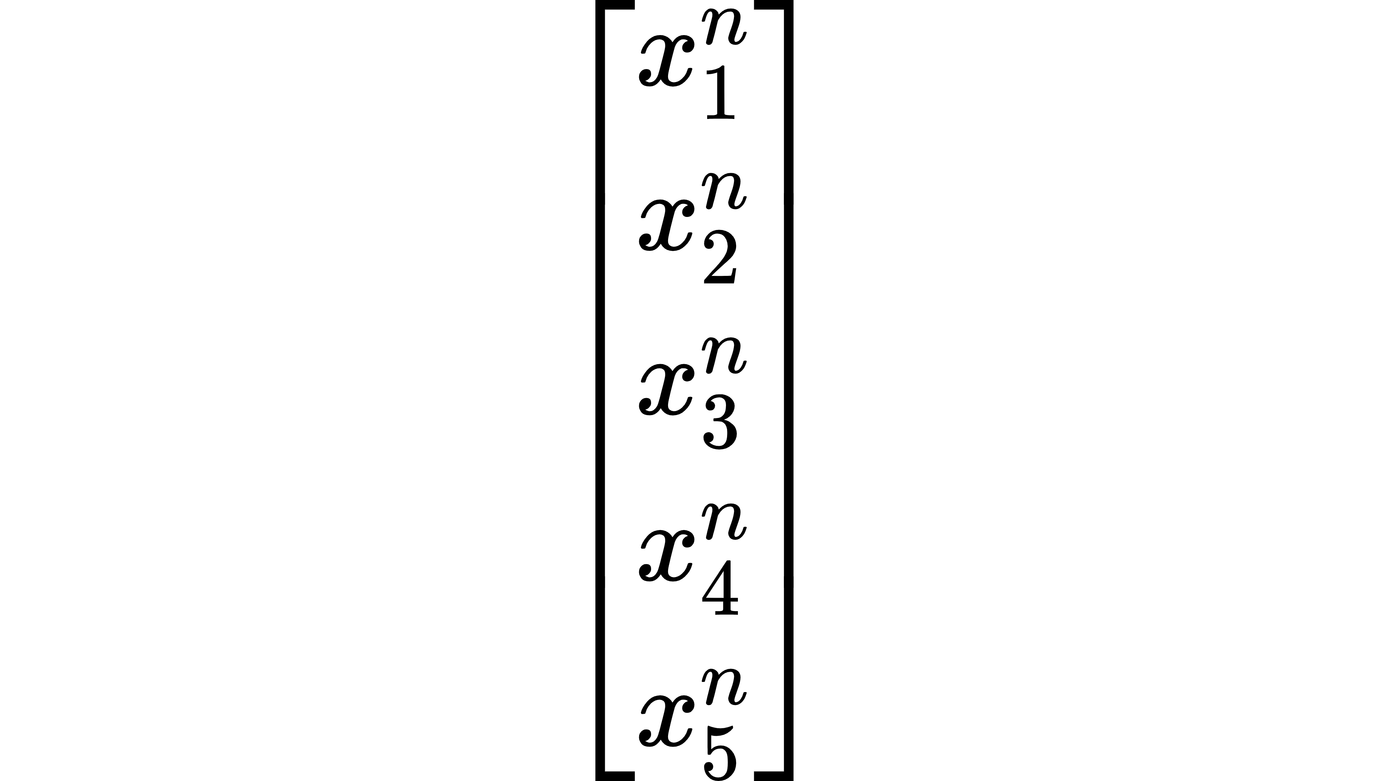
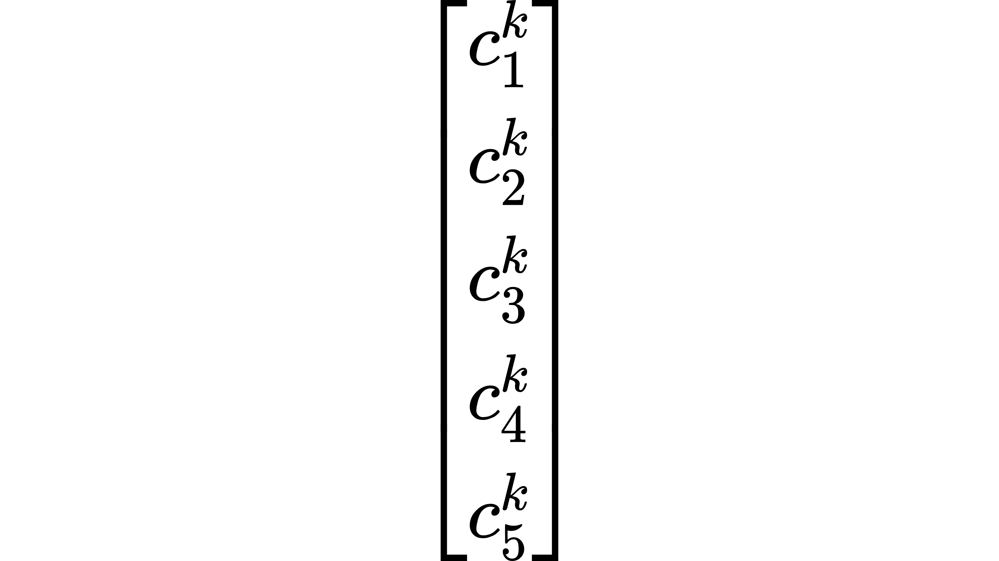
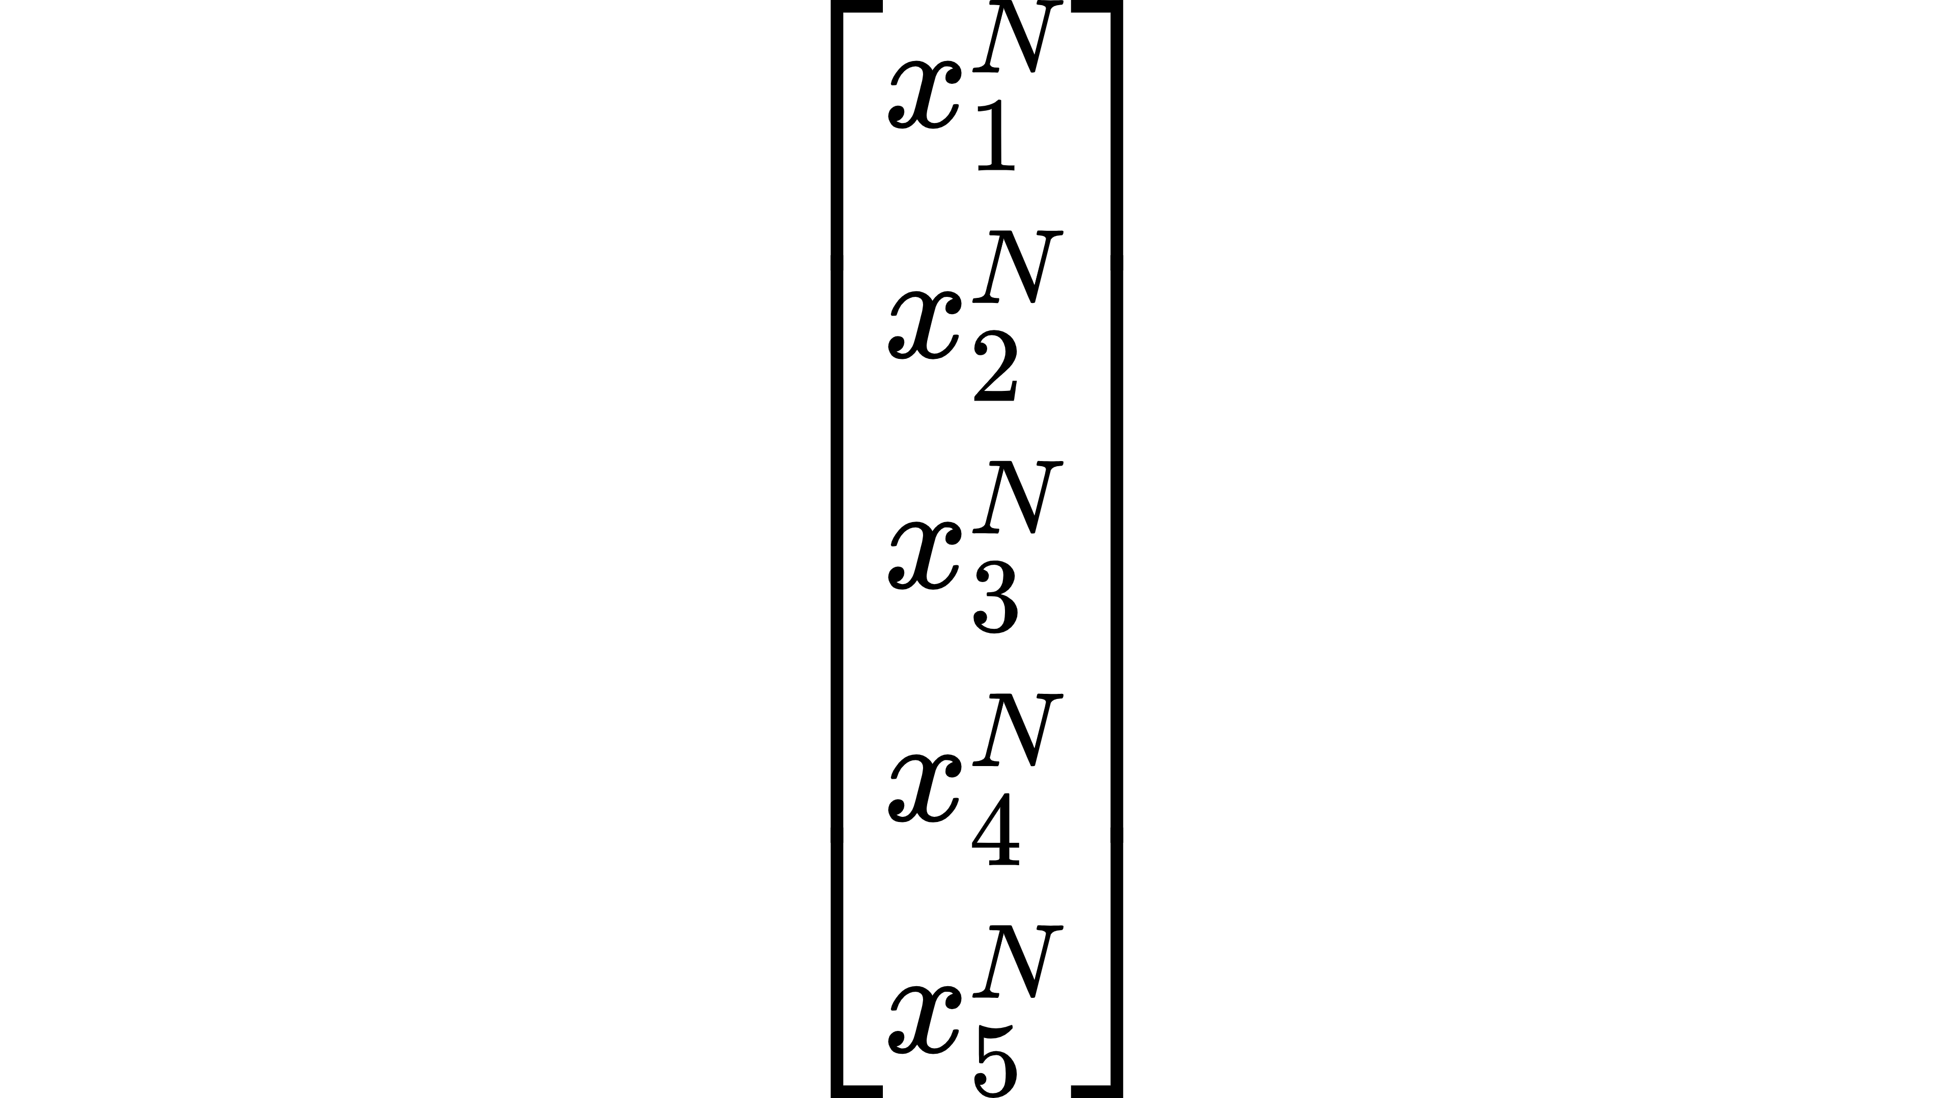
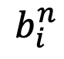
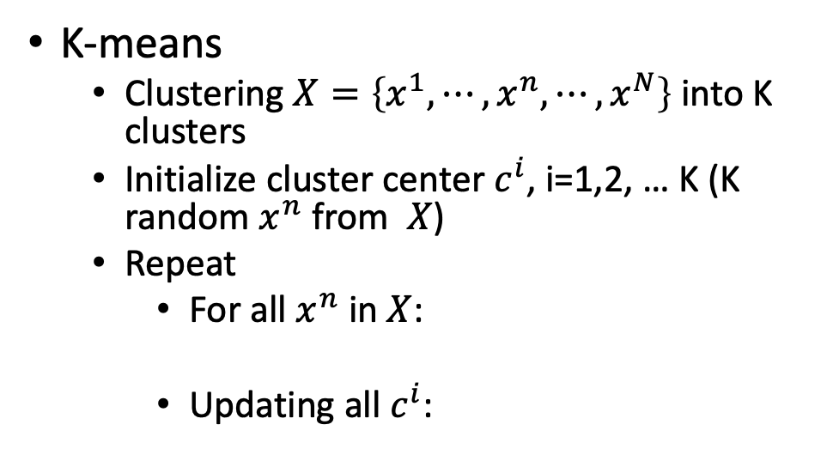
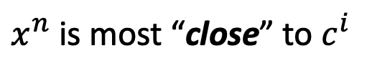
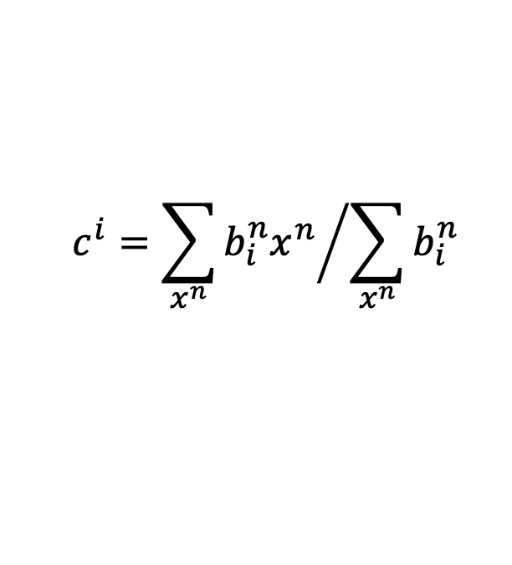
Clustering
K-means
Clustering $X=\left\{x^{1},⋯,x^{n},⋯,x^{N}\right\}$ into K clusters
Initialize cluster center $c^{i}$, i=1,2, … K (K random $x^{n}$ from $X$)
Repeat
For all $x^{n}$ in $X$:
Updating all $c^{i}$:
1
$x^{n}$ is most “close” to $c^{i}$
$$b_{i}^{n}$$
0
Otherwise
$$c^{i}={\sum_{x^{n}}{b_{i}^{n}x^{n}}}/{\sum_{x^{n}}{b_{i}^{n}}}$$

Slide 5
Clustering
Hierarchical Agglomerative Clustering (HAC)
root
Step 1: build a tree
Step 2: pick a threshold
Notes:
https://www.semanticscholar.org/paper/Integrating-frame-based-and-segment-based-dynamic-Chan-Lee/7d8eaf612500420a125b3cfca98701114cf68873/pdf

Slide 6
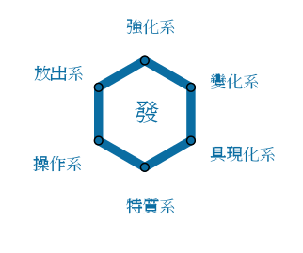
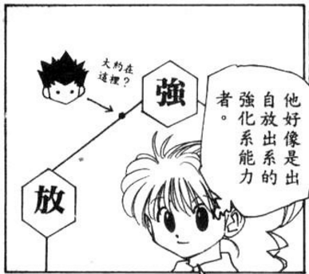
Distributed Representation
Clustering: an object must belong to one cluster
Distributed representation
小傑是強化系
Dimension Reduction
強化系 | 0.70
放出系 | 0.25
變化系 | 0.05
操作系 | 0.00
具現化系 | 0.00
特質系 | 0.00
小傑是
Notes:
克己派（Abnegation）、友好派（Amity）、無畏派（Dauntless）、直言派（Candor）以及博學派（Erudite）

Slide 7
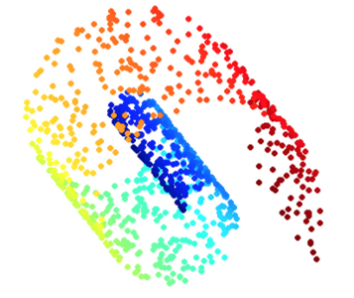
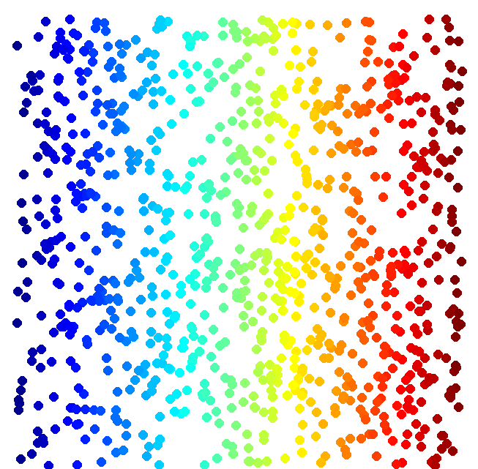
Dimension Reduction
Looks like 3-D
Actually, 2-D
http://reuter.mit.edu/blue/images/research/manifold.png
http://archive.cnx.org/resources/51a9b2052ae167db310fda5600b89badea85eae5/isomapCNXtrue1.png

Slide 8
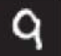
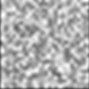
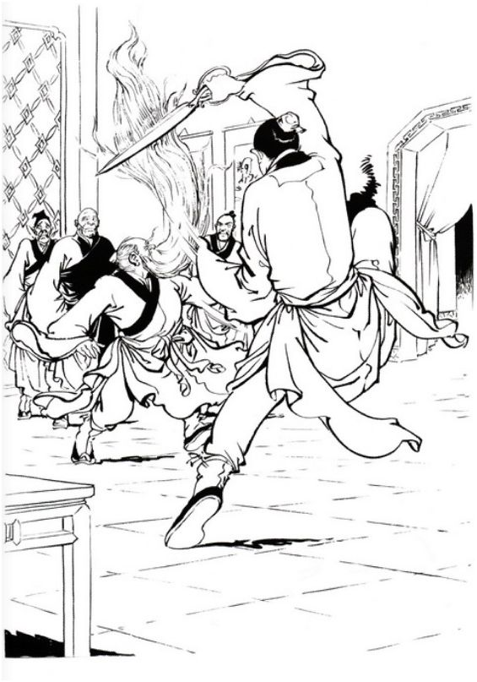
Dimension Reduction
In MNIST, a digit is 28 x 28 dims.
Most 28 x 28 dim vectors are not digits
3
3
3
3
3
-20。
-10。
0。
10。
20。
Notes:
用這個例子http://newsletter.sinica.edu.tw/file/file/4/485.pdf

Slide 9
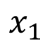
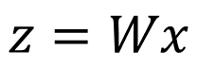
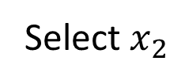
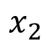
Dimension Reduction
Feature selection
Principle component analysis (PCA)
function
The dimension of z would be smaller than x
x
z
$$x_{2}$$
Select $x_{2}$
?
$$x_{1}$$
[Bishop, Chapter 12]
$$z=Wx$$

Slide 10
Principle Component Analysis (PCA)

Slide 11
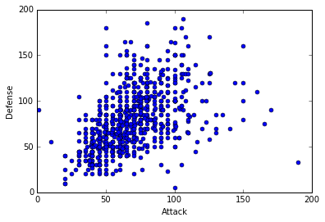
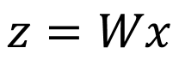
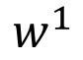
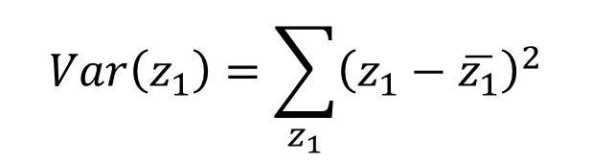

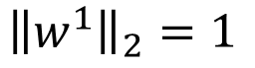
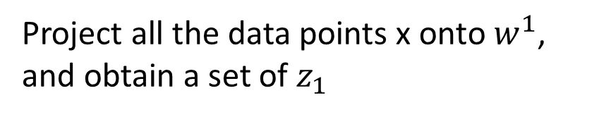
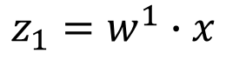
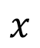
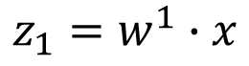
PCA
$$z=Wx$$
Large variance
Reduce to 1-D:
$$z_{1}=w^{1}∙x$$
Small variance
$$x$$
Project all the data points x onto $w^{1}$, and obtain a set of $z_{1}$
$$w^{1}$$
We want the variance of $z_{1}$ as large as possible
$$Var\left(z_{1}\right)=\sum_{z_{1}}{{\left(z_{1}−\overline{z_{1}}\right)}^{2}}$$
$$z_{1}=w^{1}∙x$$
$${\left\|w^{1}\right\|}_{2}=1$$

Slide 12
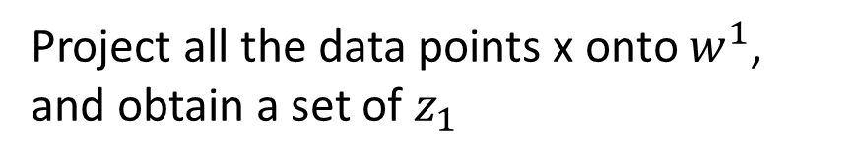
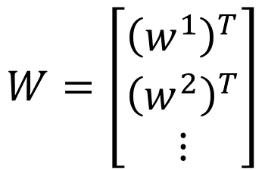
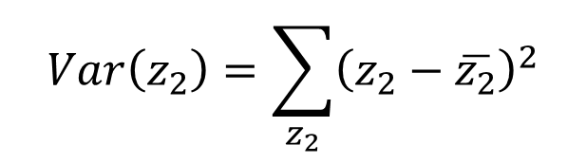
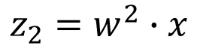

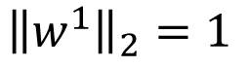
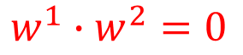



PCA
Project all the data points x onto $w^{1}$, and obtain a set of $z_{1}$
We want the variance of $z_{1}$ as large as possible
$$z=Wx$$
$$Var\left(z_{1}\right)=\sum_{z_{1}}{{\left(z_{1}−\overline{z_{1}}\right)}^{2}}$$
Reduce to 1-D:
$${\left\|w^{1}\right\|}_{2}=1$$
$$z_{1}=w^{1}∙x$$
$$z_{2}=w^{2}∙x$$
We want the variance of $z_{2}$ as large as possible
$$W=\left[\begin{aligned}{\left(w^{1}\right)}^{T} \\ {\left(w^{2}\right)}^{T} \\ ⋮\end{aligned}\right]$$
$$Var\left(z_{2}\right)=\sum_{z_{2}}{{\left(z_{2}−\overline{z_{2}}\right)}^{2}}$$
$${\left\|w^{2}\right\|}_{2}=1$$
$$w^{1}∙w^{2}=0$$
Orthogonal matrix

Slide 13
Warning of Math

Slide 14


















PCA
$$z_{1}=w^{1}∙x$$
$$\overline{z_{1}}=\frac{1}{N}\sum{z_{1}}=\frac{1}{N}\sum{w^{1}∙x}$$
$$=w^{1}∙\frac{1}{N}\sum{x}$$
$$=w^{1}∙\overline{x}$$
$$Var\left(z_{1}\right)=\frac{1}{N}\sum_{z_{1}}{{\left(z_{1}−\overline{z_{1}}\right)}^{2}}$$
$${\left(a∙b\right)}^{2}={\left(a^{T}b\right)}^{2}$$
$$=a^{T}ba^{T}b$$
$$=\frac{1}{N}\sum_{x}{{\left(w^{1}∙x−w^{1}∙\overline{x}\right)}^{2}}$$
$$=a^{T}b{\left(a^{T}b\right)}^{T}$$
$$=a^{T}bb^{T}a$$
$$=\frac{1}{N}\sum{{\left(w^{1}∙\left(x−\overline{x}\right)\right)}^{2}}$$
Find $w^{1}$ maximizing
$$=\frac{1}{N}\sum{{\left(w^{1}\right)}^{T}\left(x−\overline{x}\right){\left(x−\overline{x}\right)}^{T}w^{1}}$$
$${\left(w^{1}\right)}^{T}Sw^{1}$$
$$={\left(w^{1}\right)}^{T}\frac{1}{N}\sum{\left(x−\overline{x}\right){\left(x−\overline{x}\right)}^{T}}w^{1}$$
$${\left\|w^{1}\right\|}_{2}={\left(w^{1}\right)}^{T}w^{1}=1$$
$$={\left(w^{1}\right)}^{T}Cov\left(x\right)w^{1}$$
$$S=Cov\left(x\right)$$

Slide 15













Find $w^{1}$ maximizing
$${\left(w^{1}\right)}^{T}Sw^{1}$$
$${\left(w^{1}\right)}^{T}w^{1}=1$$
$$S=Cov\left(x\right)$$
Symmetric
positive-semidefinite
(non-negative eigenvalues)
Using Lagrange multiplier [Bishop, Appendix E]
$g\left(w^{1}\right)=$ ${\left(w^{1}\right)}^{T}Sw^{1}−α\left({\left(w^{1}\right)}^{T}w^{1}−1\right)$
$${∂g\left(w^{1}\right)}/{∂w_{1}^{1}=0}$$
$$Sw^{1}−αw^{1}=0$$
$${∂g\left(w^{1}\right)}/{∂w_{2}^{1}=0}$$
$$Sw^{1}=αw^{1}$$
$w^{1}$ : eigenvector
…
$${\left(w^{1}\right)}^{T}Sw^{1}=α{\left(w^{1}\right)}^{T}w^{1}$$
$$=α$$
Choose the maximum one
$w^{1}$ is the eigenvector of the covariance matrix S
Corresponding to the largest eigenvalue $λ_{1}$
Notes:
Ref: http://speech.ee.ntu.edu.tw/~tlkagk/courses/LA_2016/Lecture/special%20matrix%20(v2).ecm.mp4/index.html

Slide 16



















Find $w^{2}$ maximizing
$${\left(w^{2}\right)}^{T}Sw^{2}$$
$${\left(w^{2}\right)}^{T}w^{2}=1$$
$${\left(w^{2}\right)}^{T}w^{1}=0$$
$g\left(w^{2}\right)=$ ${\left(w^{2}\right)}^{T}Sw^{2}−α\left({\left(w^{2}\right)}^{T}w^{2}−1\right)$
$$−β\left({\left(w^{2}\right)}^{T}w^{1}−0\right)$$
$${∂g\left(w^{2}\right)}/{∂w_{1}^{2}=0}$$
$$Sw^{2}−αw^{2}−βw^{1}=0$$
0
0
1
$${\left(w^{1}\right)}^{T}Sw^{2}−α{\left(w^{1}\right)}^{T}w^{2}−β{\left(w^{1}\right)}^{T}w^{1}=0$$
$${∂g\left(w^{2}\right)}/{∂w_{2}^{2}=0}$$
$$={\left({\left(w^{1}\right)}^{T}Sw^{2}\right)}^{T}$$
$$={\left(w^{2}\right)}^{T}S^{T}w^{1}$$
…
$$={\left(w^{2}\right)}^{T}Sw^{1}$$
$$=λ_{1}{\left(w^{2}\right)}^{T}w^{1}$$
$$=0$$
$$Sw^{1}=λ_{1}w^{1}$$
$β=0$:
$$Sw^{2}−αw^{2}=0$$
$$Sw^{2}=αw^{2}$$
$w^{2}$ is the eigenvector of the covariance matrix S
Corresponding to the 2nd largest eigenvalue $λ_{2}$

Slide 17














PCA - decorrelation
$$z=Wx$$
$$z_{2}$$
$$Cov\left(z\right)=D$$
PCA
Diagonal matrix
$$z_{1}$$
$$Cov\left(z\right)=\frac{1}{N}\sum{\left(z−\overline{z}\right){\left(z−\overline{z}\right)}^{T}}$$
$$=WSW^{T}$$
$$S=Cov\left(x\right)$$
$$=WS\left[\begin{matrix}w^{1} & ⋯ & w^{K}\end{matrix}\right]$$
$$=W\left[S\begin{matrix}w^{1} & ⋯ & Sw^{K}\end{matrix}\right]$$
$$=W\left[λ_{1}\begin{matrix}w^{1} & ⋯ & λ_{K}w^{K}\end{matrix}\right]$$
$$=\left[λ_{1}\begin{matrix}{Ww}^{1} & ⋯ & λ_{K}{Ww}^{K}\end{matrix}\right]$$
$$=\left[λ_{1}\begin{matrix}e_{1} & ⋯ & λ_{K}e_{K}\end{matrix}\right]$$
$$=D$$
Diagonal matrix

Slide 18
End of Warning
Notes:
So many good explaination !!!!!!!!!!!!!!!!!
http://stats.stackexchange.com/questions/2691/making-sense-of-principal-component-analysis-eigenvectors-eigenvalues

Slide 19









PCA – Another Point of View
Basic Component:
1
0
1
0
1
…….
u¹
u²
u³
u⁴
u⁵
$$\left[\begin{aligned}1 \\ 0 \\ 1 \\ 0 \\ 1 \\ ⋮\end{aligned}\right]$$
1x
1x
1x
$$≈$$
+
+
u¹
u³
u⁵
$$\left[\begin{aligned}c_{1} \\ c_{2} \\ ⋮ \\ c_{K}\end{aligned}\right]$$
$$x≈c_{1}u^{1}+c_{2}u^{2}+⋯+c_{K}u^{K}+\overline{x}$$
Represent a digit image
Pixels in a digit image
component
Notes:
https://pvirie.wordpress.com/2016/03/29/linear-autoencoders-do-pca/
https://pvirie.wordpress.com/2013/10/01/pattern-covariance-analysis-of-components/

Slide 20








PCA – Another Point of View
$$x−\overline{x}≈c_{1}u^{1}+c_{2}u^{2}+⋯+c_{K}u^{K}$$
$$=\hat{x}$$
Reconstruction error:
$${\left\| (x−\overline{x})−\hat{x}\right\|}_{2}$$
Find $\left\{u^{1},…,u^{K}\right\}$ minimizing the error
$$L=\min_{\left\{u^{1},…,u^{K}\right\}}{\sum{{\left\|\left(x−\overline{x}\right)−\left(\sum_{k=1}^{K}{c_{k}u^{k}}\right)\right\|}_{2}}}$$
PCA:
$$z=Wx$$
$$\hat{x}$$
$$\left[\begin{aligned}z_{1} \\ z_{2} \\ ⋮ \\ z_{K}\end{aligned}\right]=\left[\begin{aligned}{\left(w_{1}\right)}^{T} \\ {\left(w_{2}\right)}^{T} \\ ⋮ \\ {\left(w_{K}\right)}^{T}\end{aligned}\right]x$$
$\left\{w^{1},w^{2},…w^{K}\right\}$ is the component $\left\{u^{1},u^{2},…u^{K}\right\}$ minimizing L
Proof in [Bishop, Chapter 12.1.2]

Slide 21













$$x−\overline{x}≈c_{1}u^{1}+c_{2}u^{2}+⋯+c_{K}u^{K}$$
$$=\hat{x}$$
Reconstruction error:
$${\left\| (x−\overline{x})−\hat{x}\right\|}_{2}$$
Find $\left\{u^{1},…,u^{K}\right\}$ minimizing the error
$$x^{1}−\overline{x}≈c_{1}^{1}u^{1}+c_{2}^{1}u^{2}+⋯$$
$$x^{2}−\overline{x}≈c_{1}^{2}u^{1}+c_{2}^{2}u^{2}+⋯$$
$$x^{3}−\overline{x}≈c_{1}^{3}u^{1}+c_{2}^{3}u^{2}+⋯$$
……
u¹
u²
$$c_{1}^{1}$$
$$c_{1}^{2}$$
$$c_{1}^{3}$$
…
$$≈$$
$$c_{2}^{2}$$
…
$$c_{2}^{1}$$
$$c_{2}^{3}$$
Minimize Error
…
…
…
Matrix X
Notes:
Link PCA with MDS
[1] T. Cox and M. Cox. Multidimensional Scaling. Chapman Hall, Boca Raton, 2nd edition, 2001.

Slide 22









$$x^{1}−\overline{x}$$
u¹
u²
$$c_{1}^{1}$$
$$c_{1}^{2}$$
$$c_{1}^{3}$$
…
$$≈$$
…
$$c_{2}^{1}$$
$$c_{2}^{2}$$
$$c_{2}^{3}$$
Minimize Error
…
…
…
Matrix X
M x N
M x K
K x K
K x N
X
U
∑
V
$$≈$$
K columns of U: a set of orthonormal eigen vectors corresponding to the k largest eigenvalues of XX^{T}
This is the solution of PCA
SVD:
http://speech.ee.ntu.edu.tw/~tlkagk/courses/LA_2016/Lecture/SVD.pdf

Slide 23















PCA looks like a neural network with one hidden layer (linear activation function)
Autoencoder
If $\left\{w^{1},w^{2},…w^{K}\right\}$ is the component $\left\{u^{1},u^{2},…u^{K}\right\}$
$$\hat{x}=\sum_{k=1}^{K}{c_{k}w^{k}}$$
To minimize reconstruction error:
$$x−\overline{x}$$
$$c_{k}=\left(x−\overline{x}\right)∙w^{k}$$
$K=2$:
$$w_{1}^{1}$$
$$w_{1}^{1}$$
$${\hat{x}}_{1}$$
$$c_{1}$$
$$w_{2}^{1}$$
$$w_{2}^{1}$$
$$x−\overline{x}$$
$${\hat{x}}_{2}$$
$$w_{3}^{1}$$
$$w_{3}^{1}$$
$${\hat{x}}_{3}$$
Notes:
$$K=2$$

Slide 24









PCA looks like a neural network with one hidden layer (linear activation function)
Autoencoder
If $\left\{w^{1},w^{2},…w^{K}\right\}$ is the component $\left\{u^{1},u^{2},…u^{K}\right\}$
$$\hat{x}=\sum_{k=1}^{K}{c_{k}w^{k}}$$
To minimize reconstruction error:
$$x−\overline{x}$$
$$c_{k}=\left(x−\overline{x}\right)∙w^{k}$$
$K=2$:
It can be deep.
Deep Autoencoder
$${\hat{x}}_{1}$$
$$c_{1}$$
Minimize error
$$w_{1}^{2}$$
$$x−\overline{x}$$
$${\hat{x}}_{2}$$
$$x−\overline{x}$$
$$w_{1}^{2}$$
$$c_{2}$$
$$w_{2}^{2}$$
$$w_{2}^{2}$$
Gradient Descent?
$$w_{3}^{2}$$
$${\hat{x}}_{3}$$
$$w_{3}^{2}$$
Notes:
$$K=2$$

Slide 25


Weakness of PCA
Unsupervised
Linear
PCA
Non-linear dimension reduction in the following lectures
LDA
http://www.astroml.org/book_figures/chapter7/fig_S_manifold_PCA.html

Slide 26


PCA - Pokémon
Inspired from: https://www.kaggle.com/strakul5/d/abcsds/pokemon/principal-component-analysis-of-pokemon-data
800 Pokemons, 6 features for each (HP, Atk, Def, Sp Atk, Sp Def, Speed)
How many principle components?
$$\frac{λ_{i}}{λ_{1}+λ_{2}+λ_{3}+λ_{4}+λ_{5}+λ_{6}}$$
 | $$λ_{1}$$ | $$λ_{2}$$ | $$λ_{3}$$ | $$λ_{4}$$ | $$λ_{5}$$ | $$λ_{6}$$
ratio | 0.45 | 0.18 | 0.13 | 0.12 | 0.07 | 0.04
Using 4 components is good enough
Notes:
[ 0.45190665 0.18225358 0.12979086 0.12011089 0.07142337 0.04451466]

Slide 27





PCA - Pokémon
 | HP | Atk | Def | Sp Atk | Sp Def | Speed
PC1 | 0.4 | 0.4 | 0.4 | 0.5 | 0.4 | 0.3
PC2 | 0.1 | 0.0 | 0.6 | -0.3 | 0.2 | -0.7
PC3 | -0.5 | -0.6 | 0.1 | 0.3 | 0.6 | 0.1
PC4 | 0.7 | -0.4 | -0.4 | 0.1 | 0.2 | -0.3
強度
防禦(犧牲速度)

Slide 28




PCA - Pokémon
 | HP | Atk | Def | Sp Atk | Sp Def | Speed
PC1 | 0.4 | 0.4 | 0.4 | 0.5 | 0.4 | 0.3
PC2 | 0.1 | 0.0 | 0.6 | -0.3 | 0.2 | -0.7
PC3 | -0.5 | -0.6 | 0.1 | 0.3 | 0.6 | 0.1
PC4 | 0.7 | -0.4 | -0.4 | 0.1 | 0.2 | -0.3
特殊防禦(犧牲攻擊和生命)
生命力強
Notes:
幸福蛋
雷吉艾斯
壺壺

Slide 29


PCA - MNIST
$$=a_{1}w^{1}+a_{2}w^{2}+⋯$$
images
30 components:
Eigen-digits

Slide 30


PCA - Face
30 components:
http://www.cs.unc.edu/~lazebnik/research/spring08/assignment3.html
Eigen-face
Notes:
Example of an original image of ORL face database

Slide 31


What happens to PCA?
$$=a_{1}w^{1}+a_{2}w^{2}+⋯$$
PCA involves adding up and subtracting some components (images)
Then the components may not be “parts of digits”
Non-negative matrix factorization (NMF)
Forcing $a_{1}$, $a_{2}$ …… be non-negative
additive combination
Forcing $w^{1}$, $w^{2}$…… be non-negative
More like “parts of digits”
Ref: Daniel D. Lee and H. Sebastian Seung. "Algorithms for non-negative matrix factorization." Advances in neural information processing systems. 2001.
Can be any real number

Slide 32

NMF on MNIST
Notes:
http://www2.imm.dtu.dk/projects/spasm/references/spasm.pdf

Slide 33

NMF on Face
Notes:
reshape(W(:,i)

Slide 34
Matrix Factorization

Slide 35




Matrix Factorization
Number in table: number of figures a person has
A | 5 | 3 | 0 | 1
B | 4 | 3 | 0 | 1
C | 1 | 1 | 0 | 5
D | 1 | 0 | 4 | 4
E | 0 | 1 | 5 | 4
There are some common factors behind otakus and characters.
http://www.quuxlabs.com/blog/2010/09/matrix-factorization-a-simple-tutorial-and-implementation-in-python/
Notes:
平澤唯
Figure
We can do dimension reduction on otakus and characters individually.

Slide 36
Matrix Factorization
The factors are latent.
No one cares ……
Not directly observable
呆
呆
match
A
傲
傲
呆
呆
B
傲
呆
傲
呆
C
傲
呆
傲
傲

Slide 37


















呆
$$r^{1}$$
$$r^{2}$$
$$r^{3}$$
$$r^{4}$$
傲
A | 5 | 3 | 0 | 1
B | 4 | 3 | 0 | 1
C | 1 | 1 | 0 | 5
D | 1 | 0 | 4 | 4
E | 0 | 1 | 5 | 4
$$r^{A}$$
$$r^{B}$$
$$r^{C}$$
Matrix X
$$r^{D}$$
$$r^{E}$$
No. of Otaku = M
No. of characters = N
No. of latent factor = K
N
K
N
$$r^{A}∙r^{1}≈5$$
$$n_{A1}$$
$$n_{A2}$$
r^{A}
r¹
r²
$$r^{B}∙r^{1}≈4$$
$$×$$
K
M
$$n_{B1}$$
$$n_{B2}$$
$$≈$$
N
r^{B}
$$r^{C}∙r^{1}≈1$$
Matrix X
Minimize Error
Singular value decomposition (SVD)
……

Slide 38








$$r^{j}$$
$$r^{1}$$
$$r^{2}$$
$$r^{3}$$
$$r^{4}$$
$$r^{i}$$
A | 5 | 3 | ? | 1
B | 4 | 3 | ? | 1
C | 1 | 1 | ? | 5
D | 1 | ? | 4 | 4
E | ? | 1 | 5 | 4
$$r^{A}$$
$$n_{A1}$$
$$r^{B}$$
$$r^{C}$$
$$r^{D}$$
$$r^{E}$$
Only considering the defined value
$$r^{A}∙r^{1}≈5$$
Minimizing
$$r^{B}∙r^{1}≈4$$
$$L=\sum_{\left(i,j\right)}{{\left(r^{i}∙r^{j}−n_{ij}\right)}^{2}}$$
$$r^{C}∙r^{1}≈1$$
……
Find $r^{i}$ and $r^{j}$ by gradient descent

Slide 39

$$r^{1}$$
$$r^{2}$$
$$r^{3}$$
$$r^{4}$$
A | 5 | 3 | ? | 1
B | 4 | 3 | ? | 1
C | 1 | 1 | ? | 5
D | 1 | ? | 4 | 4
E | ? | 1 | 5 | 4
$$r^{A}$$
$$n_{A1}$$
-0.4
$$r^{B}$$
-0.3
$$r^{C}$$
2.2
$$r^{D}$$
0.6
$$r^{E}$$
0.1
Assume the dimensions of r are all 2 (there are two factors)
A | 0.2 | 2.1
B | 0.2 | 1.8
C | 1.3 | 0.7
D | 1.9 | 0.2
E | 2.2 | 0.0
1 (春日) | 0.0 | 2.2
2 (炮姐) | 0.1 | 1.5
3 (姐寺) | 1.9 | -0.3
4 (小唯) | 2.2 | 0.5

Slide 40






More about Matrix Factorization
Considering the induvial characteristics
Ref: Matrix Factorization Techniques For Recommender Systems
$$r^{A}∙r^{1}≈5$$
$$r^{A}∙r^{1}+b_{A}+b_{1}≈5$$
$b_{A}$: otakus A likes to buy figures
$b_{1}$: how popular character 1 is
$$L=\sum_{\left(i,j\right)}{{\left(r^{i}∙r^{j}+b_{i}+b_{j}−n_{ij}\right)}^{2}}$$
Minimizing
Find $r^{i}$, $r^{j}$, $b_{i}$, $b_{j}$ by gradient descent
(can add regularization)

Slide 41

Matrix Factorization for Topic analysis
character$→$document, otakus$→$word
Latent semantic analysis (LSA)
Probability latent semantic analysis (PLSA)
Thomas Hofmann, Probabilistic Latent Semantic Indexing, SIGIR, 1999
latent Dirichlet allocation (LDA)
Blei, David M.; Ng, Andrew Y.; Jordan, Michael I (January 2003). Lafferty, John, ed. "Latent Dirichlet Allocation". Journal of Machine Learning Research. 3 (4–5): pp. 993–1022.
Number in Table:
 | Doc 1 | Doc 2 | Doc 3 | Doc 4
投資 | 5 | 3 | 0 | 1
股票 | 4 | 0 | 0 | 1
總統 | 1 | 1 | 0 | 5
選舉 | 1 | 0 | 0 | 4
立委 | 0 | 1 | 5 | 4
Term frequency
(weighted by inverse document frequency)
Latent factors are topics (財經、政治 …… )

Slide 42
More Related Approaches Not Introduced
Multidimensional Scaling (MDS) [Alpaydin, Chapter 6.7]
Only need distance between objects
Probabilistic PCA [Bishop, Chapter 12.2]
Kernel PCA [Bishop, Chapter 12.3]
non-linear version of PCA
Canonical Correlation Analysis (CCA) [Alpaydin, Chapter 6.9]
Independent Component Analysis (ICA)
Ref: http://cis.legacy.ics.tkk.fi/aapo/papers/IJCNN99_tutorialweb/
Linear Discriminant Analysis (LDA) [Alpaydin, Chapter 6.8]
Supervised

Slide 43
Acknowledgement
感謝 彭冲 同學發現引用資料的錯誤
感謝 Hsiang-Chih Cheng 同學發現投影片上的錯誤

